Slide 1

UNDERSTANDING COMPETITIVE COLLEGE ADMISSIONS

Slide 2

MATHSP SERVICES
Academic Coaching
(one-on-one)
MathSP Academic Coaches help our students excel in any STEM subject:
  Arithmetic
  Algebra
  Geometry
  Pre-Calculus/Trig
  Calculus
  Economics
  Physics
  Biology
  Chemistry
Test Prep Coaching
(one-on-one or small group course)
MathSP Test Prep Coaches help our students reach their target scores on the following tests:
  SSAT (all sections)
  PSAT/NMSQT (all sections)
  SAT (all sections
  ACT (all sections)
  SAT Subjects Tests (Math & Science)
  AP Exams (Math & Science)
  GRE
  GMAT

Slide 3
ACCESS 2 ADMISSION SERVICE
Academic Life Coaching
(ideal for students in 8th-11th Grades)
  Personalized College Readiness Assessment
  Academic Scheduling Guidance
  Student Portfolio Development
  Note Taking Skills
  Career Exploration
  College Matching
  Essay Writing Assistance
  Scholarship Assistance
  Summer Enrichment Advisement
College Coaching
(ideal for students in 11th and 12th Grades)
  College Matching
  “Rock Your Interview” Training
  Start-to-Finish College Application Assistance
  Start-to-Finish Scholarship Application Assistance
  College Essay Coaching
  Financial Aid Guidance

Slide 4
6 KEY INGREDIENTS FOR SUCCESS
01
Rigorous Academic Curriculum
02
Inspiring Letters of Recommendation
03
Stellar Test Scores
04
Meaningful Activities
05
Dynamic Essays
06
Personal Interview

Slide 5


THERE IS NO COOKIE-CUTTER RECIPE
Admission
is an ART,
not a science
“Beauty is being the lone red flower in a field of yellow.”
– Andy Warhol

Slide 6

WHAT COURSES ARE YOU TAKING?
01
Rigorous Academic Curriculum
02
Inspiring Letters of Recommendation
03
Stellar Test Scores
04
Meaningful Activities
05
Dynamic Essays
06
Personal Interview

Slide 7

RIGOROUS ACADEMIC CURRICULUM
AP
HONORS
DUAL ENROLLMENT
IB

Slide 8



ADVANCED PLACEMENT EXAMS
38 AP courses across seven areas: Math & Computer Science, Sciences, History & Social Science, English, World Languages & Cultures, Arts, and Capstone
Offered once per year in May and scored on a 5-point scale, 5 being “extremely well qualified” and 1 being “no recommendation”
Stand out in the college admission process
Earn college credit and advanced placement
Move into upper level courses, more electives, double-major, and study abroad

Slide 9
HOW WELL DO YOUR TEACHERS KNOW YOU?
01
Rigorous Academic Curriculum
02
Inspiring Letters of Recommendation
03
Stellar Test Scores
04
Meaningful Activities
05
Dynamic Essays
06
Personal Interview

Slide 10

YOUR TEACHERS’ OPINIONS OF YOU MATTER
In most cases, you will need to ask (2) academic teachers for recommendations.
Students earn their recommendations everyday through their class contributions.
What were you like to teach?
Do you participate in class? Ask for help after class?
Does your teacher know you outside of the classroom?

Slide 11

ARE YOU PREPARED TO ROCK YOUR TESTS?
01
Rigorous Academic Curriculum
02
Inspiring Letters of Recommendation
03
Stellar Test Scores
04
Meaningful Activities
05
Dynamic Essays
06
Personal Interview

Slide 12

START EARLY AND HAVE A PLAN
aCT
SAT
AP EXAMS
PSAT/NMSQT
SAT SUBJECT TESTS

Slide 13

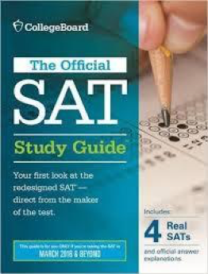

SAT
5 timed sections in 3 content areas including Reading Test (65 min), Writing & Language Test (35 min), Math – Two Tests (one with calculator and one without calculator, 80 min total), and optional Essay (50 min)
Composite score range of 400-1600 (200-800 per two content areas: Reading/Writing & Language and Math); Essay reported in 3 dimensions (Reading/Analysis/Writing), each scored from 2-8
Reading and Writing & Language Tests includes graphic information

Slide 14

SAT (CONT.)
Math includes Arithmetic, Algebra I and II, Geometry, and Trigonometry concepts with 4 response multiple-choice and grid-in questions
No penalty for wrong answers
Can take the SAT more than once –
Super Score
Administered by the College Board seven times per year: March, May, June, August, October, November, and December

Slide 15


ACT
5 timed sections in 5 content areas including Math Section (60 min), Reading Section (35 min), Science Section (35 min), English Section (45 min), and optional Writing (30 min)
Composite score range of of 1-36 (and 1-36 per five content areas)
Math section includes Arithmetic, Algebra (advanced topics such as complex numbers), Geometry, and Trigonometry concepts with 5 response multiple-choice questions only
Science section includes chemistry, biology, and physical science questions based on graphs, charts, tables, and diagrams
No penalty for guessing
Administered by the ACT six times per year: September, October, December, February , April, and June

Slide 16

SAT SUBJECT TESTS
English (Literature), History (U.S. History, World History), Math (Level 1 and Level 2-includes pre-calculus/trig), Science (Biology Ecological, Biology Molecular, Chemistry), Language (12 tests)
Many of the country's top colleges and universities require students take two or more SAT Subject Tests, including:
Boston College Boston University
Rice Brown Cornell
Duke Dartmouth MIT
NYU Wellesley Yale Harvard
Other schools recommend the SAT subject tests, and strong scores will certainly strengthen an application.
Visit college’s website for more information; colleges change their admissions criteria often.

Slide 17

TEST PREP TIME LINE
8th
9th
10th
11th
12th
GRADE
GRADE
GRADE
GRADE
GRADE
Academic Coaching (Tutoring)
PSAT
SAT Subject Tests
PSAT/NMSQT
SAT and/or ACT

Slide 18

EXPLORE TEST PREP OPTIONS
Online Courses
  - Khan Academy
Large Group Courses
  - In School
Small Group Courses (MathSP)
  - Max 10 students per course
  - 28 hours over 9 weekly sessions
  - All sections of the test
  - Course Location: Emory University
One-on-One Coaching (MathSP)
  - 100% customized to meet your needs

Slide 19
HOW DO YOU SPEND YOUR TIME OUTSIDE CLASS?
01
Rigorous Academic Curriculum
02
Inspiring Letters of Recommendation
03
Stellar Test Scores
04
Meaningful Activities
05
Dynamic Essays
06
Personal Interview

Slide 20
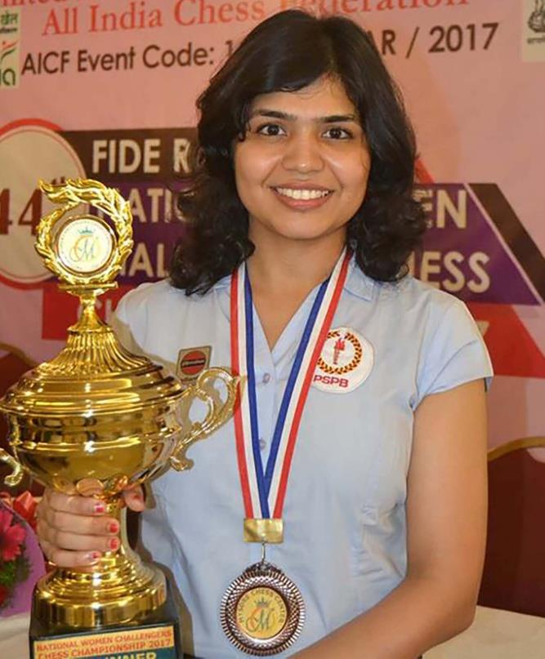
FIND YOUR PASSION AND ENGAGE
Talent-based
  Sports, Drama, Chess, Music & Art
Leadership-based
  Student Government, Model U.N., Class Office
Academically-based
  Math Team, Language Club, National Honor Society
Career-based
  Newspaper, Mock Trial, Junior Achievement
Community Service-based
  Homeless shelter, SADD, Youth Group

Slide 21
BE UNIQUE
“A college’s goal isn’t necessarily a community of well-rounded students, but a well-rounded community of unique students.
Your goal is to find a way to let the college of your choice know how you fit into their community in a unique way.”
- Muhlenberg College, Office of Admissions

Slide 22
DO YOUR ESSAYS TELL YOUR UNIQUE STORY?
01
Rigorous Academic Curriculum
02
Inspiring Letters of Recommendation
03
Stellar Test Scores
04
Meaningful Activities
05
Dynamic Essays
06
Personal Interview

Slide 23
THE DREADED COLLEGE ESSAYS: YES, THEY MATTER
  Essays are completely underappreciated! They should provide a “complete picture” of who you are: Tell your unique life story! The best essay is a genuine essay written from your own experiences.
  Admission committee members want to “feel” an intellectual spark or personal passion from your application.
  Don’t waste your time telling something that they can find somewhere in your application.
  Overcome feelings of shyness, shame, or reservation about sharing difficulties you have faced or challenges you've overcome.

Slide 24
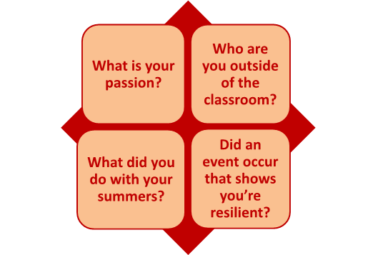
PUT YOUR ACADEMIC PERFORMANCE IN A LARGER CONTEXT

Slide 25
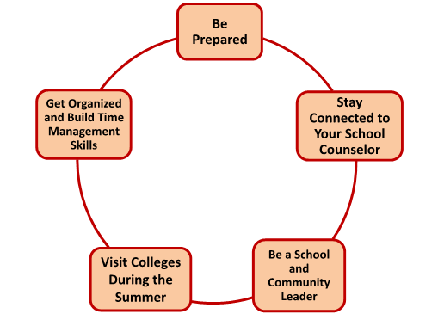
TO DO LIST FOR 9TH AND 10TH GRADERS

Slide 26
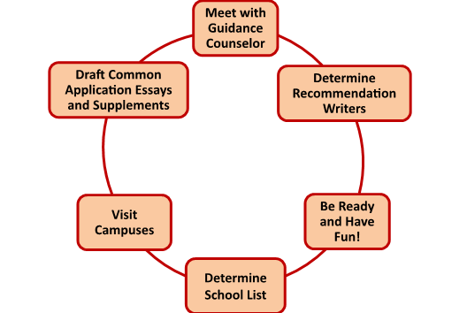
TO DO LIST FOR 11TH GRADERS

Slide 27
ARE YOU PREPARED TO BE… YOU?
01
Rigorous Academic Curriculum
02
Inspiring Letters of Recommendation
03
Stellar Test Scores
04
Meaningful Activities
05
Dynamic Essays
06
Personal Interview

Slide 28
THE DREADED COLLEGE ESSAYS: YES, THEY MATTER
The purpose of the interview is to help you learn more about the school and the school to learn more about you.
Relax – the interview is really just a casual conversation.
Talk about your “passion” – the experience that sets you apart from other applicants.
Be yourself – don’t force an interest. The interviewer is curious about the person that you are and why you chose to apply to that college.
Be timely, inquisitive, and polite.

Slide 29
WE HELP OUR STUDENTS SUCCEED
MathSP and
Access 2 Admission
Help Students Like You Everyday!
Join Our Mailing List
New: Knowledge for College Experts Membership Site

Slide 30



WE HELP OUR STUDENTS SUCCEED
www.MathSP.com
Facebook: @MathSP
Twitter: @MathSPAcademy
info@MathSP.com
www.Access2Admission.com
Twitter: @Elisa_Buckner
Instagram: @Elisa_Buckner
elisa@Access2Admission.com

Slide 31

GENERAL COURSE
EXPECTATIONS
Math
4 Years
English
4 Years
Science
4 Years
Social Studies
3 Years
Foreign Language
3 Years
Electives
Varies
BASED ON COLLEGE

Slide 32
TEMPLATES

Slide 33


Slide 34


Slide 38


